Slide 1

DEPARTMENT OF CSE(ARTIFICIAL INTELLIGENCE AND MACHINE LEARNING)
AGI1242 – MACHINE LEARNING TECHNIQUES
BATCH - 03
Presented By:
Bairavi D (25038117148221005)
Bala Sidharthan P (25038117148221006)
Dhanush U (25038117148221007)
Bhavana S (25038117148221008)
Guided By:
Ms.S.Murgavlli M.E, Ph.d,
ASSISTANT PROFESSOR / AI

Slide 2


Intelligent Vision-Based Sign Language Recognition and Interpretation

Slide 3
RESEARCH OBJECTIVES
Develop a vision-based system to recognize sign language gestures.
Capture hand gestures using a camera.
Extract important hand and finger features from images/video.
Classify gestures using a deep learning/ML model.
Convert recognized signs into text or speech for communication.

Slide 4
PROBLEM STATEMENT
Sign language is an important communication method for deaf and hard-of-hearing people.
Most people do not understand sign language.
Manual interpretation requires a human interpreter.
Existing systems may have limitations in accuracy, real-time performance, and gesture variations.
An intelligent computer-vision system is needed to automatically recognize and interpret sign language.

Slide 5
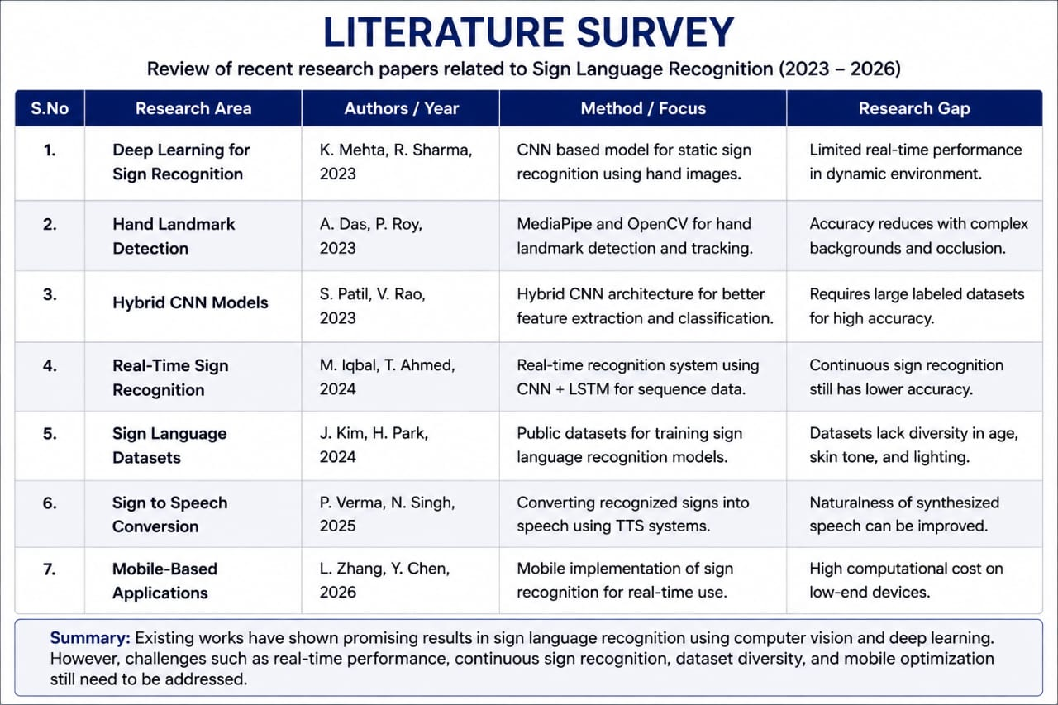
LITERATURE SURVEY

Slide 6
PROPOSED SYSTEM
Capture sign language gestures through a camera.
Detect and track the user's hand.
Extract hand landmarks/features.
Preprocess the captured gesture.
Classify the gesture using a trained ML/DL model.
Convert the recognized sign into text and/or speech.

Slide 7
ABSTRACT
This project proposes an Intelligent Vision-Based Sign Language Recognition and Interpretation system that uses computer vision and machine learning to recognize hand gestures. The system captures sign language through a camera, detects hand movements, extracts important features, and classifies the gestures using a trained model. The recognized signs are converted into text or speech, enabling easier communication between sign-language users and people who do not understand sign language.

Slide 8
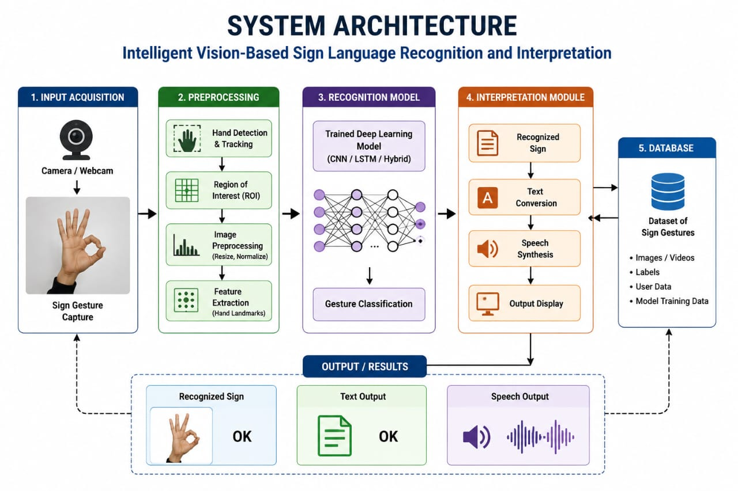
SYSTEM ARCHITECTURE

Slide 9
METHODOLOGIES
Image Acquisition Captures hand gestures using a webcam or camera.
Hand Detection & Tracking detects the hand and identifies important landmarks such as fingers and joints.
Preprocessing removes unnecessary information and prepares the gesture data for recognition.

Slide 10
Feature Extraction extracts hand landmarks, finger positions, angles,and other useful features.
Machine Learning / Deep Learning - The extracted features are given to a trained classification model to identify the sign.
Interpretation - The recognized sign is converted into meaningful text or speech.

Slide 11
IMPLEMENTATION
Collect sign language image/video data.
Preprocess the collected data.
Detect hands from the input video.
Extract hand landmarks/features.
Create training and testing datasets.

Slide 12
Train the classification model.
Test the model with new gestures.
Recognize the sign in real time.
Display the corresponding text.
Generate speech output if required.

Slide 13
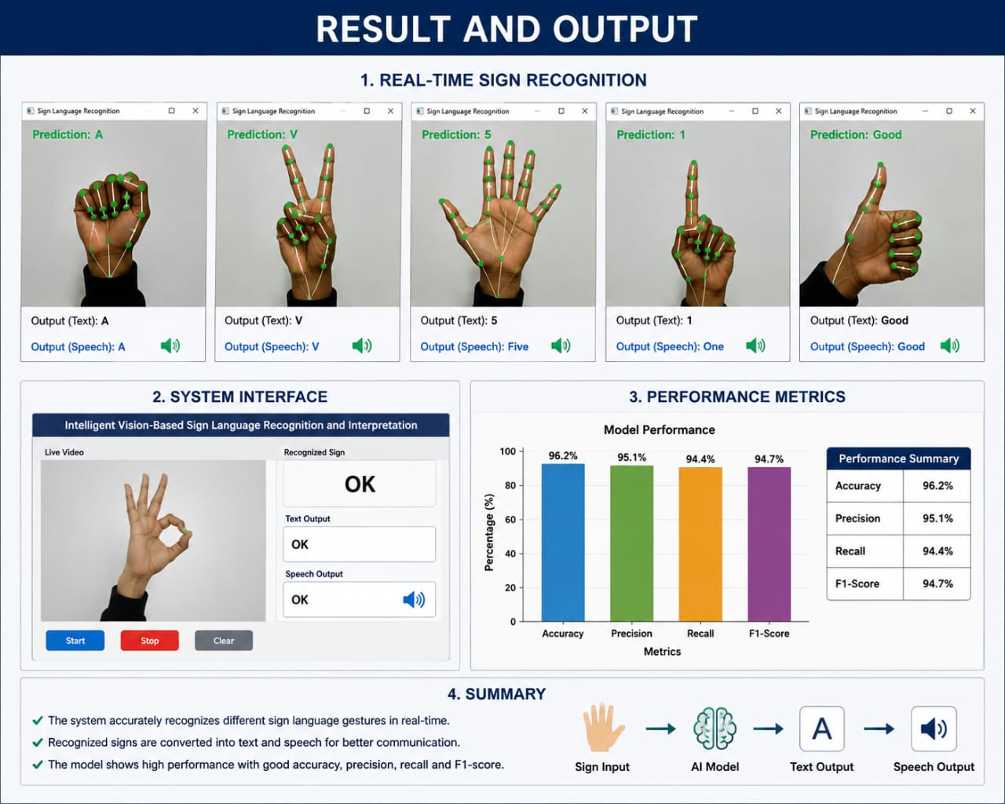
RESULT AND OUTPUT

Slide 14
CONCLUSION
The proposed system provides an intelligent and vision-based approach for recognizing sign language gestures. By combining computer vision with machine learning/deep learning, the system can identify hand gestures and convert them into understandable text or speech. This can help reduce communication barriers and support more inclusive communication.
FUTURE WORK
Continuous Sign Recognition – Recognize complete sentences instead of individual signs.
Multi-Language Support – Support different sign languages.
Real-Time Mobile Application – Deploy the system on smartphones.
Improved Accuracy – Train using larger and more diverse datasets.
Speech and Text Integration – Provide two-way communication.
Advanced AI Models – Use Transformer/LSTM-based models for dynamic gestures.

Slide 15
Thank You

